Slide 1
Lecture 02
CYBER SECURITY AND LAWS
By
Prof.Neha S.Sakhalkar

Slide 2
In Last lecture,we have seen
Why cyber security is vital nowadays
Why cybercrimes have increased
What is meant by a cybercrime and it origin
Why cybercrime is not considered as a crime
Why hacking can’t be ethical
Analogy between Information security,Cybercrime and Cyber security

Slide 3
Outline of today’s lecture
Who are cybercriminals
Classification of cybercrimes
Aspects of security*

Slide 4
Who are cybercriminals?

Slide 5
Cybercrime involves
Credit card fraud
Cyberstalking
Defaming online
Gaining unauthorized access to computer systems
Ignoring Copyright,software licensing and trademark protection
Overriding encryption to make illegal copies,software piracy
Stealing another person’s identity to perform crime

Slide 6
Cybercrime involves
Credit card fraud
Cyberstalking :
Use of internet to harass individual or organization
Defaming online :
Publishing offensive information about anybody online
Gaining unauthorized access to computer systems
Ignoring Copyright,software licensing and trademark protection : for money making
Overriding encryption to make illegal copies,software piracy : for money making
Stealing another person’s identity to perform crime
Cybercriminals are those who perform above acts

Slide 7
Motive behind cybercrimes
Greed for money
Greed for fame
Desire to gain power
Desire for a revenge
Desire for a sense of adventure
Looking for a thrill to access forbidden information
Destructive mindset

Slide 8
Categories of Cybercriminals based on their motive :
TYPE I : Cybercriminals Hungry for recognition
Hobby hackers
IT Professionals
Politically motivated hackers
TYPE II : Cybercriminals Not interested in fame
Psychological perverts
Financially motivated hackers
Wanting to do national espionage or sabotage :Military purpose
TYPE III : The insiders
Disgruntled or former employees seeking revenge
Competing companies using employees to gain economic growth through damage or theft
Ruined personal relationships

Slide 9
Classification of Cybercrimes

Slide 10
Categories of Cybercrimes
Cybercrime against individual
Cybercrime against property
Cybercrime against organization
Cybercrime against society
Crimes emanating from usenet groups

Slide 11
1.Cybercrimes against individual
e-mail spoofing and online frauds
Phishing,Spear phishing,Vishing,Smishing
Spamming
Cyberdefamation
Cyberstalking
Computer sabotage
Pornographic offenses
Password sniffing
Identity theft

Slide 12
2.Cybercrimes against property
Credit card frauds
IP Crimes
Internet time theft

Slide 13
3.Cybercrimes against organizations
Unauthorized access of computers
Password sniffing : Yahoo breach
Denial-of-service attacks : flooding the bandwidth
Virus attack
e-mail bombing : crash e-mail account
Salami attack : bank system software alteration
Logic bomb : system sabotage purpose
Trojan horse
Data Diddling : altering raw data before and after processing
Industrial espionage : Product finances,R&D,marketing strtegies
Computer network intrusions : to steal data
Software piracy

Slide 14
4.Cybercrimes against society
Forgery
Cyberterrorism
Web jacking

Slide 15
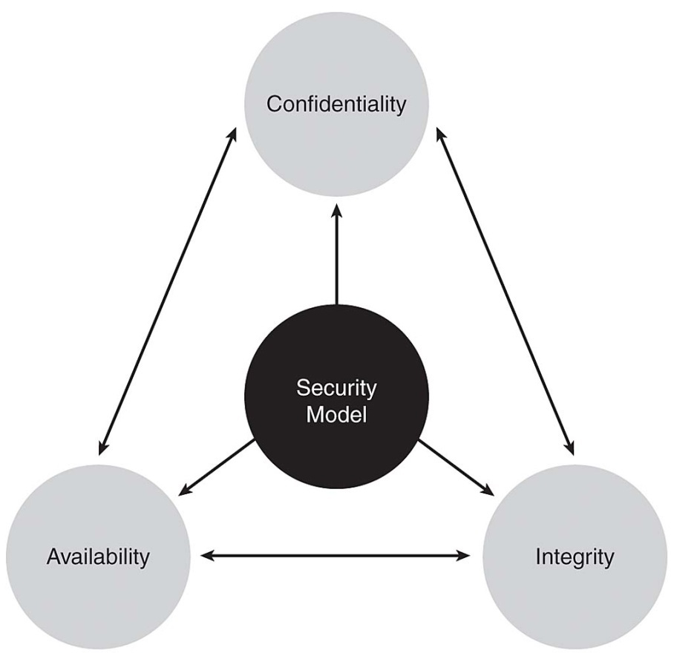
Aspects of security

Slide 16
Confidentiality
Only those authorized to view information
e.g.credit cad fraud
Integrity
Information is correct and hasn’t been altered by unauthorized users or software
e.g.yahoo breach
Availability
Data is accessible to authorized users 24*7
e.g.Website hacked

